Slide 1
Societe-Generale (Hackathon 2025)
Chandra Kumar P – 21R208
Raghul T – 21R228

Slide 2
PROBLEM STATEMENT
Develop a Blockchain based e-Vault system for store, merge and share legal records.

Slide 3
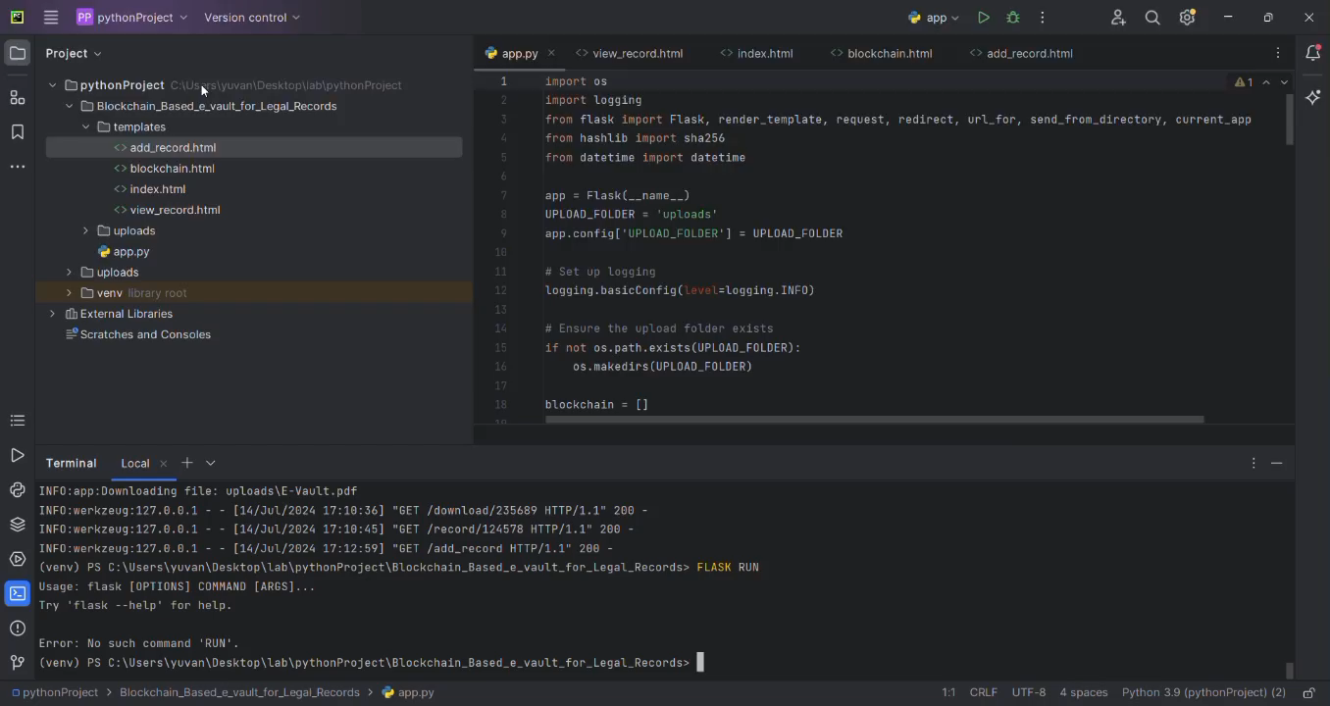
Developed solution

Slide 4
GITHUB REPOSITORY LINK
https://github.com/RaghulTG04/Developing-a-Blockchain-Based-eVault-for-Legal

